Slide 1

Department of ECE
ANALOG ELECTRONIC CIRCUIT DESIGN 22EC2104A
CO-2
Session-8 Common source amplifier

Slide 2





AIM OF THE SESSION
To familiarize students with the operatin of common source amplifier
INSTRUCTIONAL OBJECTIVES
This Session is designed to:
Give introduction amplification in CS configuration
To analysis operation of CS amplifier
LEARNING OUTCOMES
At the end of this session, you should be able to:
1. Describe the working of CS amplifier circuits.
2. Demonstrate and analyze the operation and parameters of CS amplifier.

Slide 3
INTRODUCTION
A common source amplifier is a basic configuration of a field-effect transistor (FET) amplifier. It is widely used in electronic circuits for amplifying analog signals.
In this configuration, the input signal is applied to the gate terminal, while the output is taken from the drain terminal.
The source terminal is connected to a common reference point.
The common source amplifier provides voltage amplification and offers a high input impedance, making it suitable for interfacing with various signal sources.
By utilizing the inherent voltage gain of the FET, the common source amplifier can provide amplification with low distortion and excellent linearity.
It finds applications in audio amplifiers, communication systems, and other electronic devices requiring signal amplification.

Slide 4
Common source amplifier
FET is a voltage-controlled device with three terminals -source, drain, and gate.
Based on these terminals, FET is divided into 3 amplifier configuration that corresponding to 3 configurations of Bipolar transistors.
They are common-source, common drain (source-follower), and common-gate amplifier circuits. The common – source amplifier circuit is most widely used than any other amplifier circuits because it can produce high input and output impedance, and also its performance is high.
Here is a complete description of the common-source amplifier using FET.

Slide 5
Cont..
When the input signal is applied at the gate terminal and source terminal, then the output voltage is amplified and obtained across the resistor at the load in the drain terminal.
This is called a common source amplifier.
Here source acts as a common terminal between the input and output. It is also known as a voltage amplifier or a transconductance amplifier.
It produces current gain and voltage gain according to the input impedance and output Impedance.
To produce voltage gain along with high input impedances FET’s are used in these circuits

Slide 6
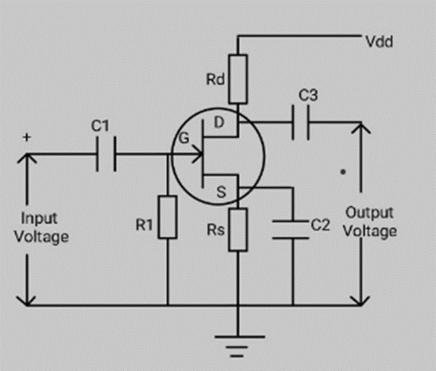
Common source amplifier circuit
The circuit diagram of the common source amplifier with N-channel FET along with the coupling and biasing capability is shown below.
This circuit will be similar to the common-emitter follower of Bipolar Junction transistor. If we use P-channel FET, the polarity of the input voltage will be reversed

Slide 7
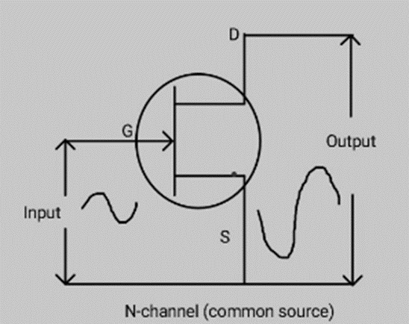
Design
The design of a common source amplifier with FET is the same as the Class A amplifier using BJT (Bipolar Junction transistor).
The design configuration of the common source amplifier using N-channel and P-channel FET is shown below

Slide 8
Frequency Response
The frequency response of this amplifier is the most important factor. The circuit designs of low frequency and audio transistor circuits are different from RF applications.
The capacitors and the type of FET used in the operation may affect the frequency response of the amplifier.
The frequency response of this amplifier is limited.
This is the main drawback.
The amplified output voltage can be applied to either a common-drain circuit ( voltage follower) or a common-gate circuit (current follower).
To obtain better frequency response, common-drain and common-gate circuits are combined to form a cascade amplifier circuit

Slide 9
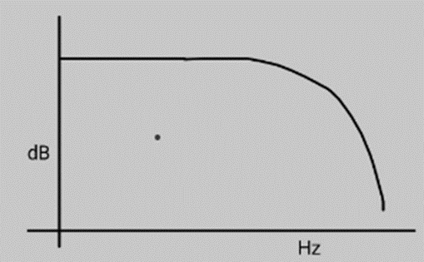
Cont…
If the biasing arrangement is improper, then some form of distortion may appear in the amplified output signal.
That is amplitude distortion, which can occur due to the effect of phase shift, clipping of signal, and also frequency distortion.
The frequency response of this amplifier with active load is shown below

Slide 10
Working
This amplifier can work as either a transconductance amplifier or a voltage amplifier.
If the amplifier is working as a transconductance amplifier, then the input signals are amplified and modulate the current flowing to the load.
If the amplifier working as a voltage amplifier, then the input signal is amplified and modulates the current passing through the FET and changes the voltage across the load resistor according to the Ohm’s law.
The common source amplifier working can be explained from the above circuit diagram. Its working is similar to the working of a common-emitter follower of the BJT circuit. When the input signal is applied at the gate terminal through the capacitor C1.

Slide 11
Cont…
The use of this capacitor is to check whether the gate terminal is affected by any DC voltage of the previous stage. The resistor R1 of around 1Mega ohms is between the gate and the ground holds the potential.
The voltage is developed across the resistor Rs that can hold the source above the ground.
The bypass capacitor C2 provides the additional gain for the AC signal.
The amplified output voltage is obtained across the resistor Rd at the load at the drain terminal of the circuit.
This amplified output voltage is coupled to the AC signal of the next stage by the capacitor C3 by blocking or eliminating the DC components.

Slide 12
Cont…
The amplified output signal of this amplifier is 180 degrees out of phase with respect to the input signal and produces.
The operation of the P-channel common source amplifier using FET is also similar to the N-channel common source amplifier FET except the voltage polarities will be reversed.
In the reverse-biased state, there will be no current flowing between gate and source. Hence the gate current is zero.

Slide 13
Cont…
Then the gate voltage (DC) is given as, high power gain
Vg = Ig x Rg
The DC voltage at source is given by,
Vs = Id x Rs
Then the gate to source voltage is given by,
Vgs = Vg – Vs = 0- Id x Rs Since Ig = 0
Vgs = – Id x Rs
Where
Id = drain current, Vgs = gate-source voltage, Vg = gate voltage, Rs = resistor at the source
Rg = resistor at Gate, Ig = gate current

Slide 14

SUMMARY
A common-source amplifier is a type of amplifier configuration used in electronic circuits. It employs a field-effect transistor (FET) or a metal-oxide-semiconductor field-effect transistor (MOSFET) in a specific arrangement.
In this configuration, the signal is applied to the gate terminal of the transistor, while the source terminal is grounded.
The amplifier amplifies the input signal and produces an output at the drain terminal.
It provides high voltage gain and is commonly used in applications such as audio amplification and voltage buffering.
The common-source amplifier offers good input and output impedance matching, making it versatile and suitable for various circuit designs.

Slide 15
SELF-ASSESSMENT QUESTIONS
1. The common-source amplifier provides:
a) Voltage gain
b) Current gain
c) Power gain
d) Transconductance gain
2. The common-source amplifier exhibits:
a) Inverting voltage gain
b) Non-inverting voltage gain
c) Unity voltage gain
d) No voltage gain

Slide 16
TERMINAL QUESTIONS
1. Draw the common source amplifier and explain the operation
2. Explain the frequency response of common source amplifier

Slide 17
REFERENCES FOR FURTHER LEARNING OF THE SESSION
Reference Books:
1. Jacob Millman - “Electronic Devices and Circuits”, 4th Edition, McGraw Hill Education (2015)
2. D Roy Choudhury and Shail B. Jain – “Linear Integrated Circuits”, 4th Edition, New Age International Pvt.Ltd. (2017)
3. David A. Bell - “Electronic Devices and Circuits”, 5th Edition, Oxford University Press (2008)
Sites and Web links:
https://www.learnelectronicswithme.com/2020/07/what-is-jfet-construction-and-working.html
https://electronicspost.com/explain-the-construction-and-working-of-a-jfet-what-is-the-difference-between-a-jfet-and-a-bjt/
https://electronicsdesk.com/junction-field-effect-transistor.html

Slide 18
THANK YOU
Team – ANALOG ELECTRONIC DEVICES AND CIRCUITS

